Slide 1
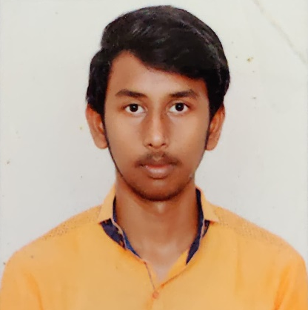

Yedire Venkata Sai Aadarsh
Analyst/Software Engineer
Vel tech university ,B.Tech,
Computer Science & Engg: 2018-2022
Skills
Azure | Completed Azure 900 certification
C# | Basics, OOPS, Exception Handling ,Arrays ,Collection and Generics, Delegates and Events, File Io and Serialization.
.NET Framework | ADO.NET,ASP.NET with MVC5 and WEB API,Entity Framework
Ado.net | Basics Architecture
Database | SQL
Tools | GIT
UI Technology | HTML5 ,CSS & Angular
Add On Skills | Communication Skills, Team Management, UI Designing (Sketching).
chennai
yvsa07@gmail.com
+91 7893441972
A4
.NET Core Full Stack Developer
Understanding of RDMS concepts using Ms SQL Server.
Practical understanding of C# and SQL concepts using Visual Studio and SQL Server.
Hands on experience in developing applications using .NET Framework, ADO.NET Core, Asp.Net Core.
Understanding of HTML5 , CSS and Angular Cli.
Proficient in creating Single page Web Application in Angular with Authentication with routing.
Trained under iTransform.
Completed Azure 900 Certification.
Online Railway Reservation System
Completed case study on Online Railway Reservation System where the users can be able to register and reserve , cancel and get the tickets sent to mail and be downloaded in pdf format where as admins can be able to add the trains, add the seats , update, delete and can view booking history of the users and the users can able to report or view the train status.
Technologies used:
ANGULAR
ASP.NET CORE
Microsoft SQL Server
Video Link : Click
GitHub Link
https://github.com/sdsameer07

